Slide 1
Digital Electronics
Principles & Applications
Fifth Edition
Roger L. Tokheim
Chapter 3
Logic Gates
©1999 Glencoe/McGraw-Hill

Slide 2
CHAPTER 3 PREVIEW
The AND Gate
The OR Gate
The Inverter
The NAND Gate
The NOR Gate
The XOR Gate
The XNOR Gate
NAND as Universal Gate
Gates with More Than Two Inputs
Using Inverters to Convert Gates
TTL & CMOS Logic Gates
Troubleshooting Gate Circuits
IEEE Logic Symbols

Slide 3
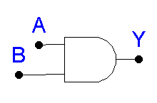
“All or Nothing Gate”
Boolean Expression: A · B = Y
Truth Table (See next slide)
The AND Gate

Slide 4
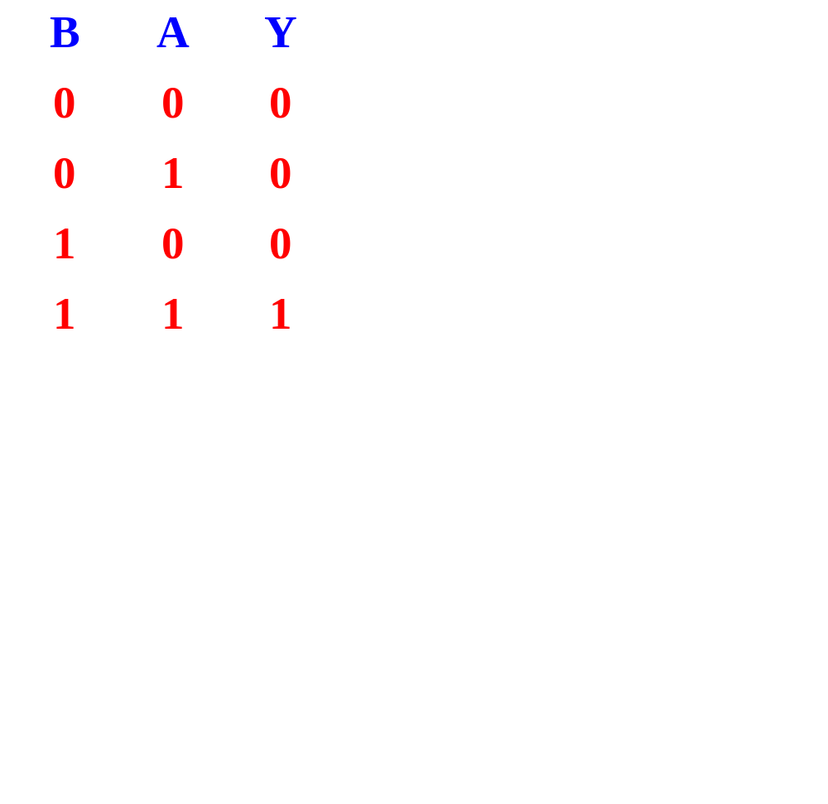
TRUTH TABLE - AND GATE

Slide 5


What is the output of the AND gate?
TEST
L
L
H
H
Low
High
?
?
L
H
H
L
Low
Low
?
?
Unique Output: Output HIGH only when all inputs are HIGH.

Slide 6
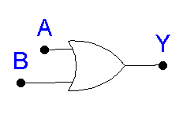
“Any or All Gate”
Boolean Expression: A + B = Y
Truth Table (See next slide)
The OR Gate

Slide 7
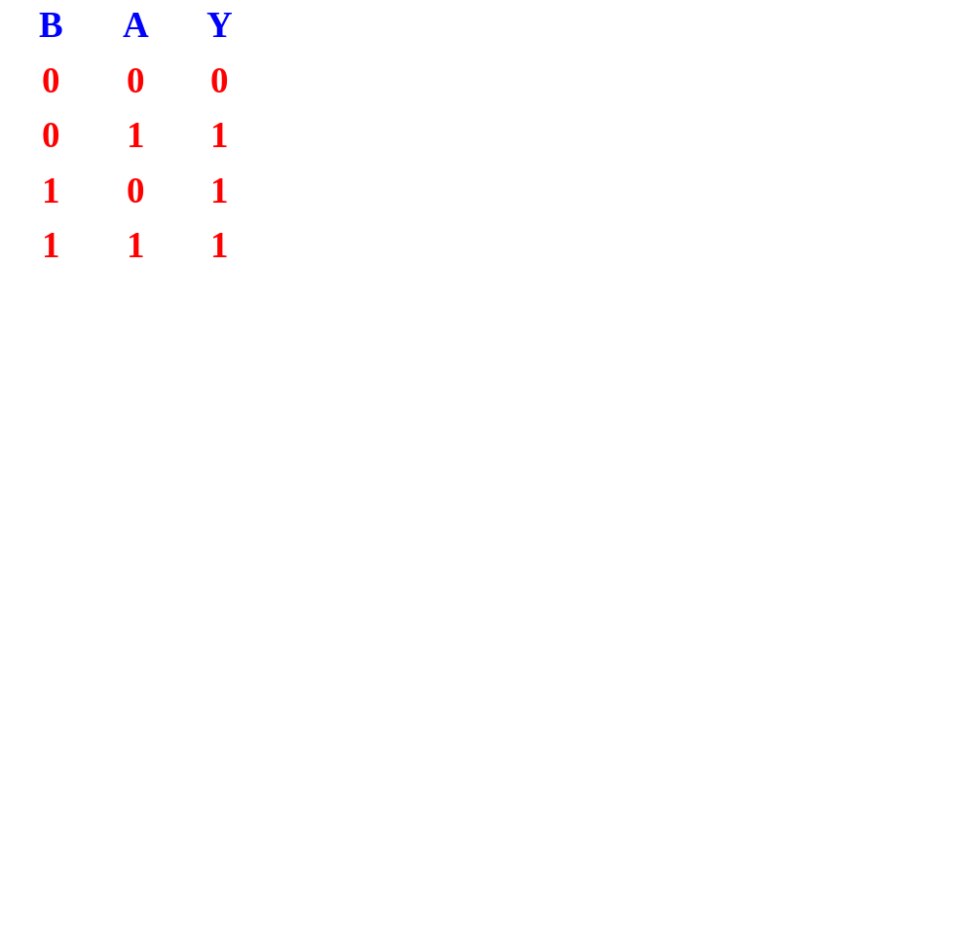
TRUTH TABLE - OR GATE

Slide 8

What is the output of the OR gate?
TEST
H
H
H
L
High
High
?
?
L
L
Low
L
H
?
High
?
Unique Output: Output LOW only when all inputs are LOW.

Slide 9
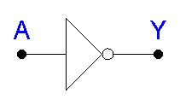
NOT Circuit
Gives output that is not the same as the input.
Boolean Expression: Y = A or Y = A'
Double inverting: A = A
The Inverter

Slide 10
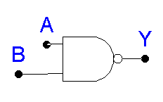
NOT AND or inverted AND function.
Boolean Expression: A · B = Y
or (A · B)' = Y
Truth Table (See next slide)
The NAND Gate

Slide 11
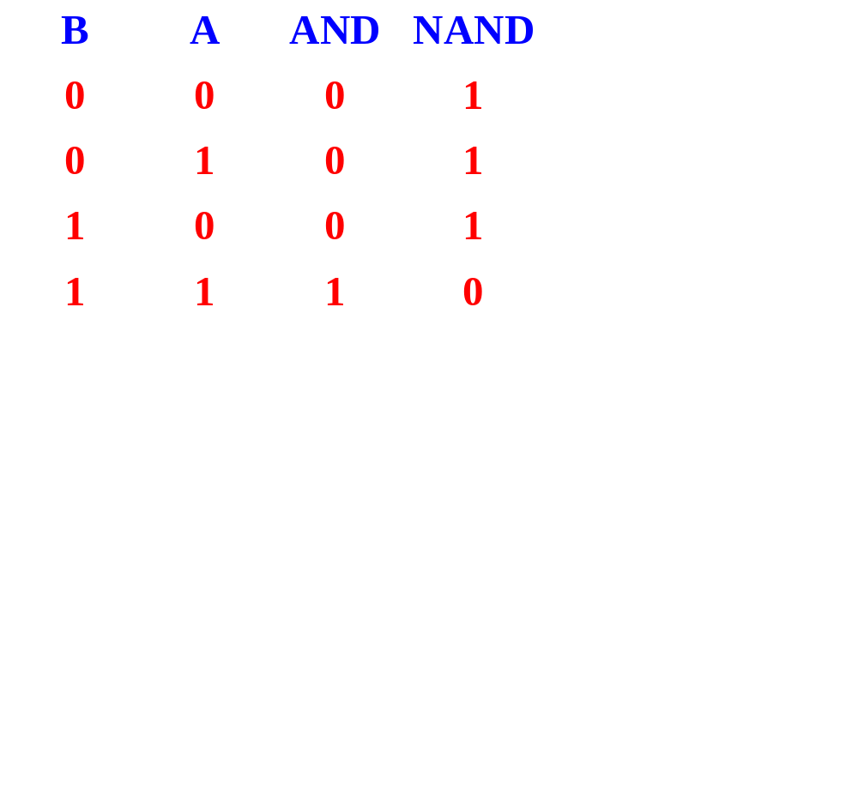
TRUTH TABLE - NAND GATE

Slide 12

What is the output of the NAND gate?
TEST
L
L
L
H
High
High
?
?
H
H
H
L
Low
High
?
?
Unique Output: Output LOW only when all inputs are HIGH.

Slide 13
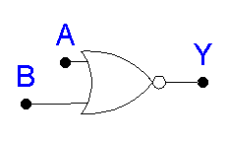
NOT OR or Inverted OR
Boolean Expression: A + B = Y
or (A + B)' = Y
Truth Table (See next slide)
The NOR Gate

Slide 14
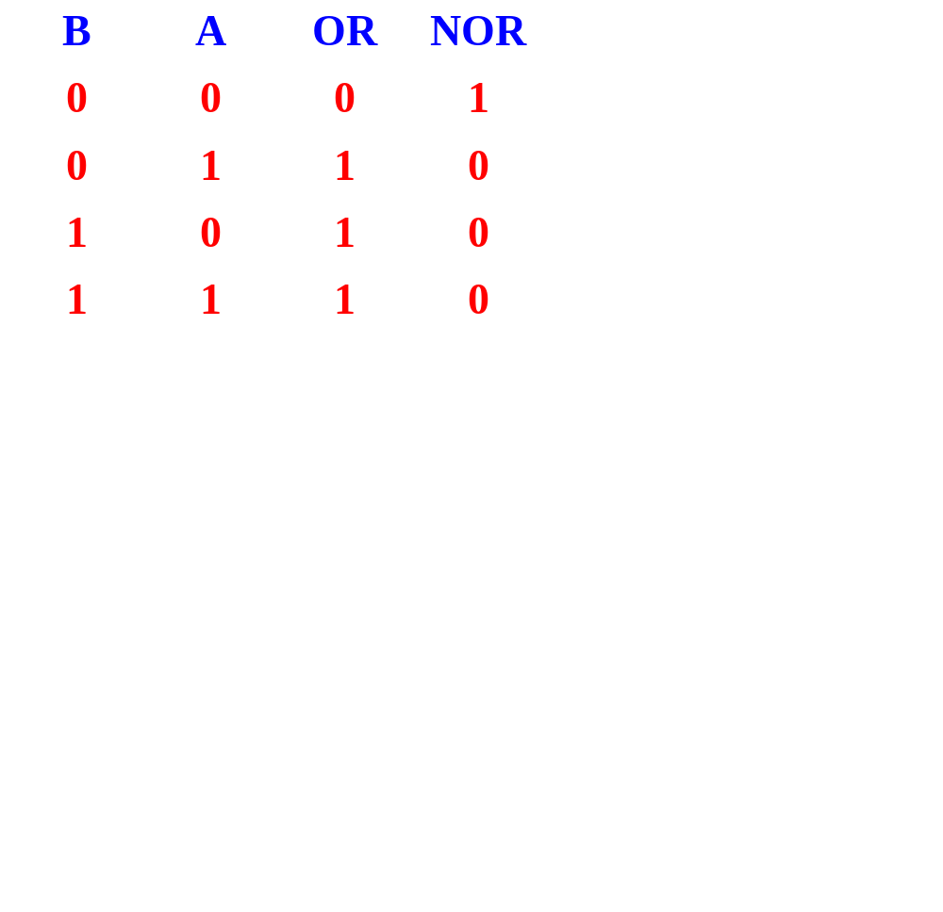
TRUTH TABLE - NOR GATE

Slide 15
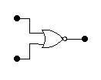
TEST
What is the output of the NOR gate?
L
L
L
H
High
Low
?
?
H
L
Low
H
H
?
Low
?
Unique Output: Output HIGH when all inputs are LOW.

Slide 16
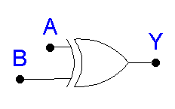
Known as “Exclusive OR” Gate
“Anything but not all” Gate
Boolean Expression: A ⊕ B = Y
Truth Table (See next slide)
The XOR Gate

Slide 17

TRUTH TABLE - XOR GATE

Slide 18

What is the output from the XOR gate?
TEST
L
L
L
L
L
H
High
?
?
?
Low
H
H
H
H
H
L
High
?
?
?
Low
XOR output is HIGH only when odd number of inputs are HIGH

Slide 19
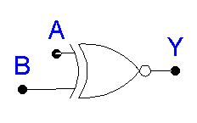
Known as the Exclusive NOR Gate
The Inverted XOR
Boolean Expression: A ⊕ B = Y
  or (A ⊕ B)' = Y
Truth Table (See next slide)
The XNOR Gate

Slide 20
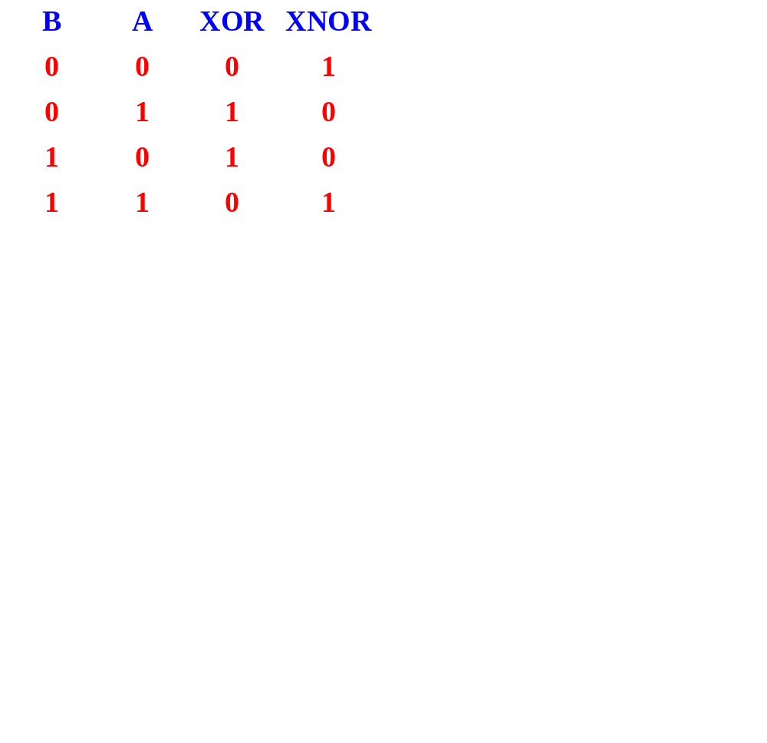
TRUTH TABLE - XNOR GATE

Slide 21

TEST
What is the output from this XNOR gate?
L
L
L
High
L
H
L
?
Low
?
H
H
L
H
H
H
Low
High
?
?
XNOR output is HIGH only when odd number of inputs are LOW

Slide 22
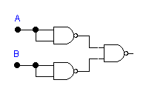

THE NAND AS A UNIVERSAL GATE
“Universal gate” can be used in combination to create any other logic function.
Example:
A + B
A + B

Slide 23
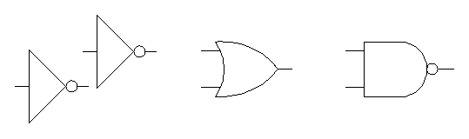
USING INVERTERS TO CONVERT GATES
For example:

Slide 24
PRACTICAL LOGIC GATES
ICs - Integrated circuits
TTL Family of ICs
CMOS (MOS - Metal oxide semiconductor) Family of ICs

Slide 25
TROUBLESHOOTING SIMPLE GATE CIRCUITS
Logic probe - equipment used to test circuits
Feel top of IC to determine if it is hot
Look for broken connections, signs of excessive heat
Smell for overheating
Check power source
Trace path of logic through circuit

Slide 26
IEEE LOGIC SYMBOLS
A different set of symbols without unique shapes.
Not very popular at this time.
Examples:
A
B
&
Y
AND gate
A
B
1
Y
OR gate

